Slide 1



Using R
Day 1 Afternoon
Notes on R
Datatypes (dataframe, matrix, list etc.)
Importing Data
Tidying
Wrangling
Descriptive Statistics
Plotting
Cory Whitney
Lisa Biber-Freudenberger
Help from tidyverse and ggplot2
#rstats

Slide 2
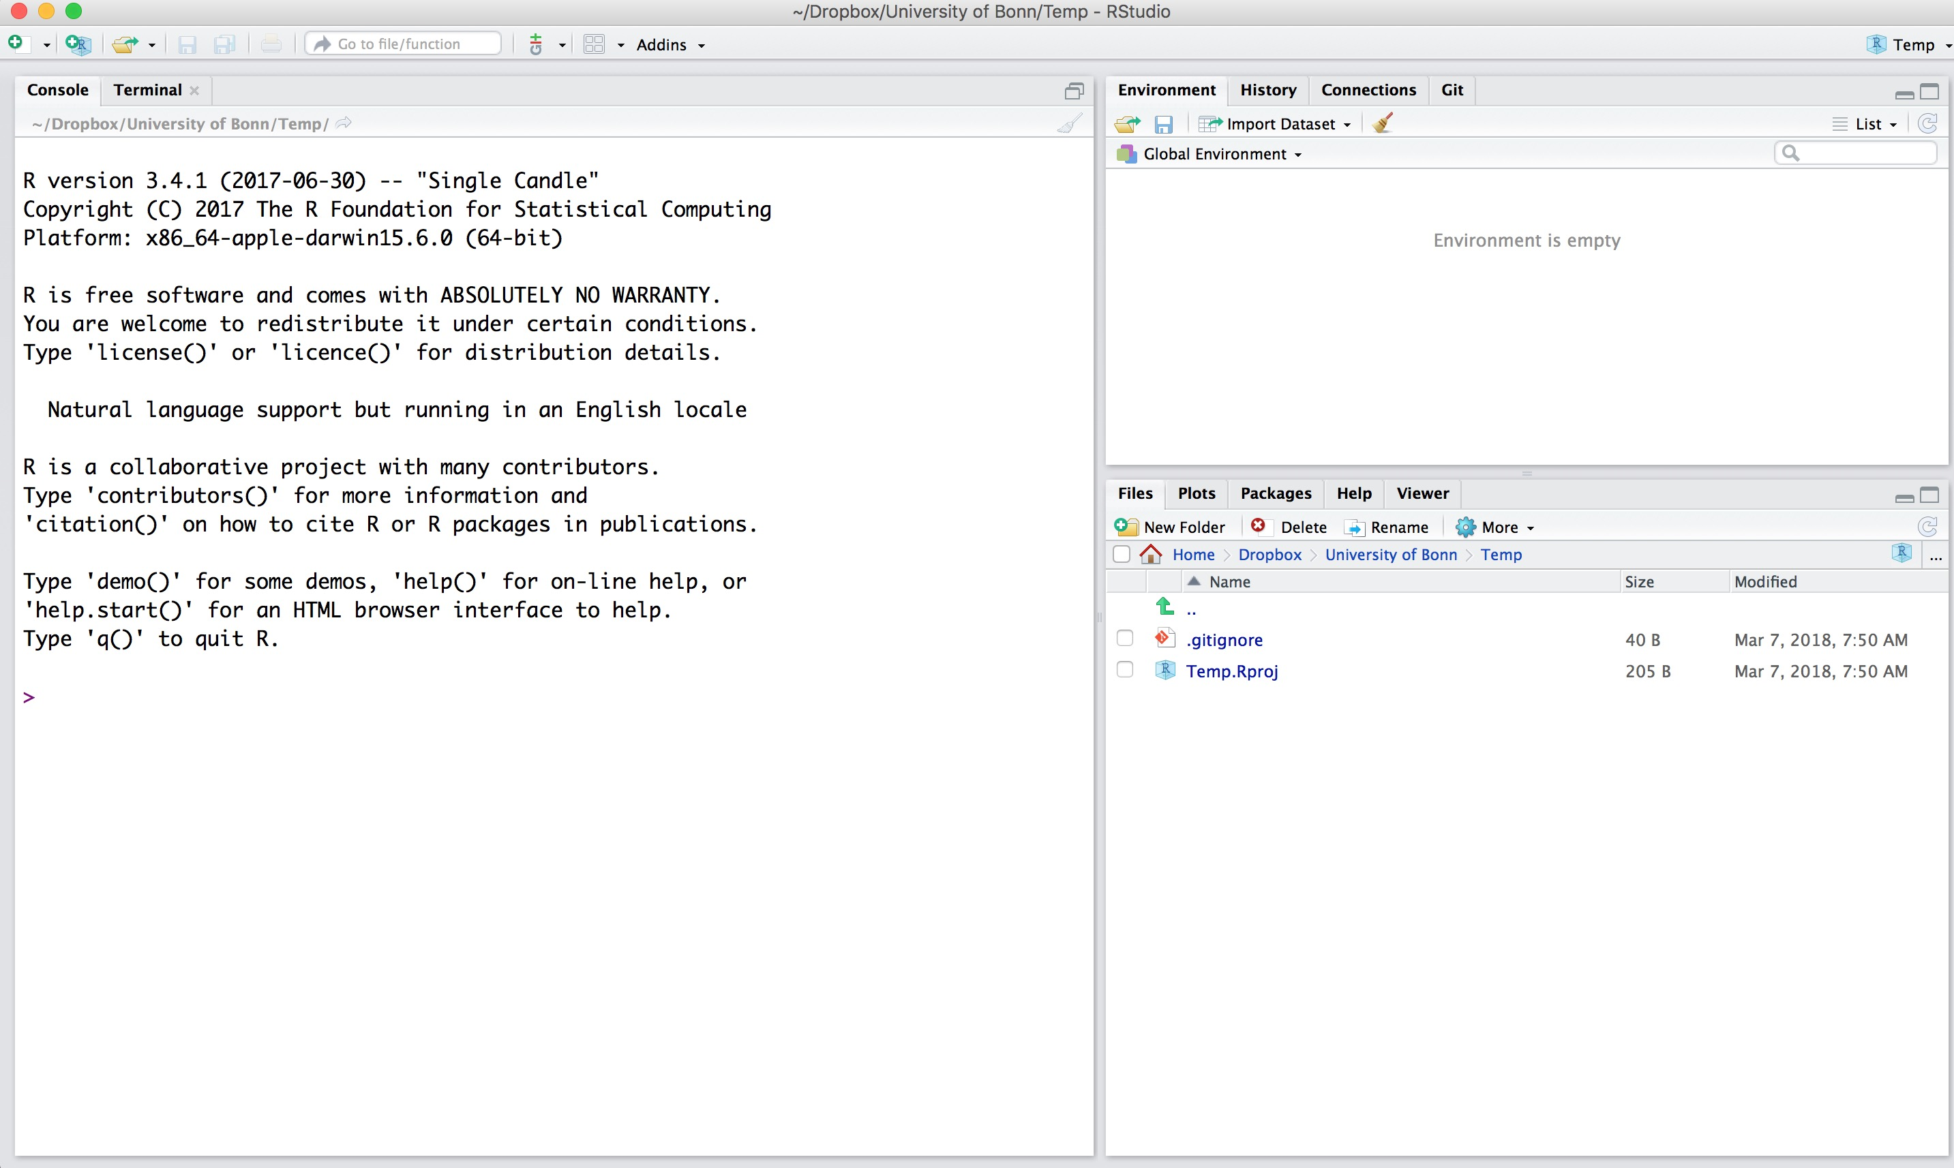
RStudio
Notes on R

Slide 3
RStudio
Notes on R
Global environment
Files, plots, packages …
Console

Slide 4
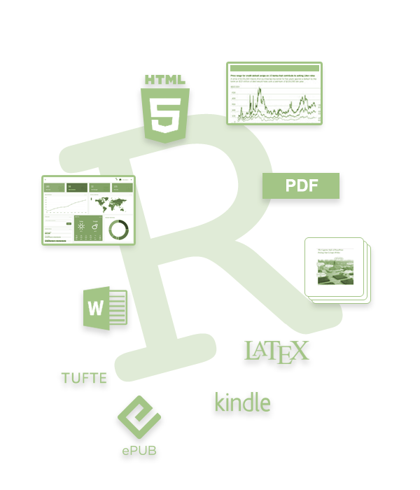

R Markdown
Notes on R
Yihui Xie
Use it!
You will thank yourself
Save often with new version
https://rmarkdown.rstudio.com/

Slide 7
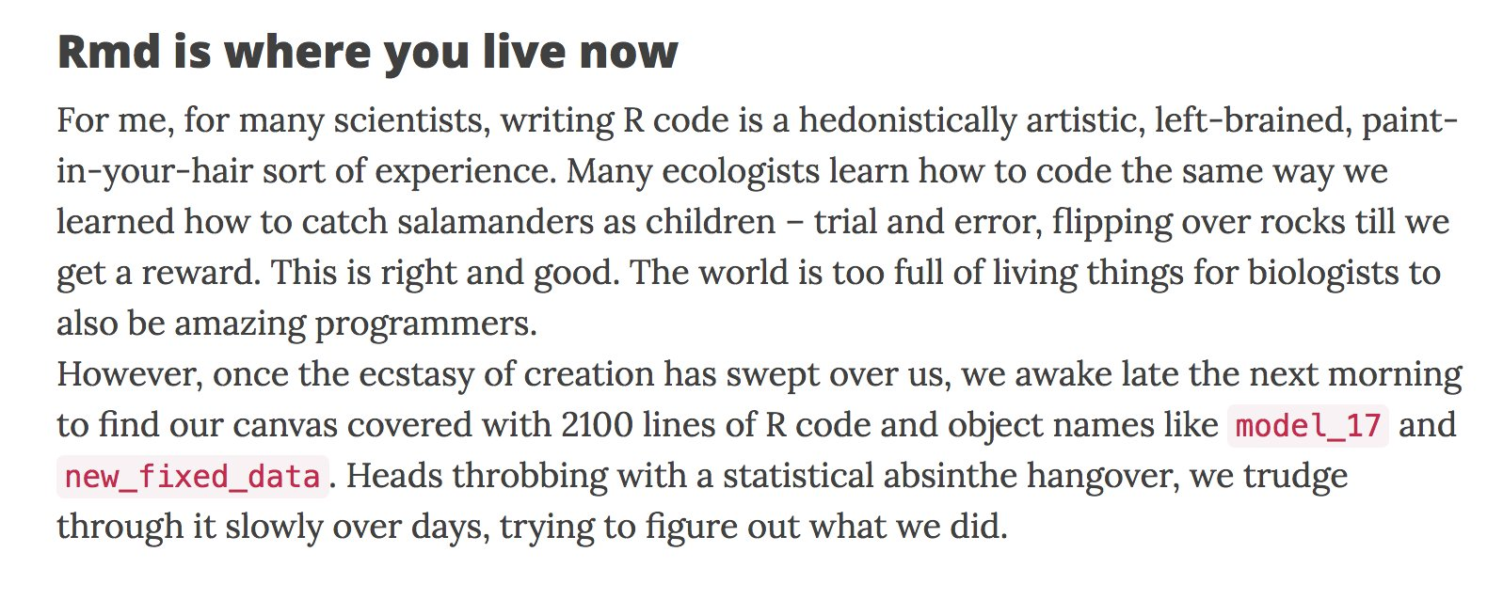

Left-brained, paint in your hair experience
Notes on R
Andrew MacDonald @polesasunder Feb 13
"How I use R Markdown" : 3 weird tricks! a blog
http://thestudyofthehousehold.com/2018/02/09/2018-02-09-how-i-use-rmarkdown/
Notes:
Lisa and I will bring you through, what will hopefully be some useful foundational tools. If you use R, then like most of us, you will probably learn the coding language because it is so useful for your incredibly specific and specialized need for it. You will master this use before you really fully get the basics.

Slide 8
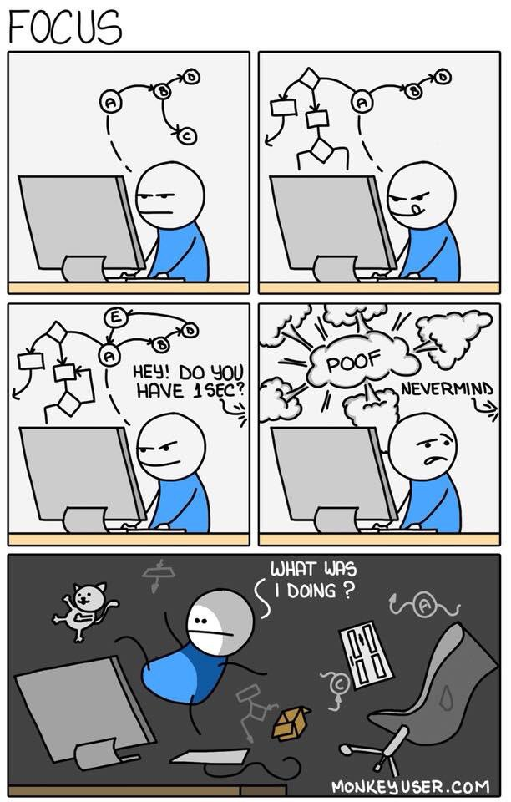
Notes on R

Slide 9
Keep it tidy
Notes on R
Use ‘#’ to annotate and not run
If not Rmarkdown then at least use ‘----’ or ‘####’
#Section 1----
#Section 2####
#Section 3####
TOC in upper right console

Slide 10
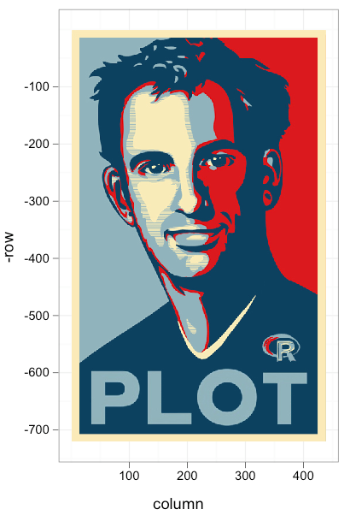
Keep it tidy
Notes on R
browseVignettes(package = "tidyverse")
Hadley Wickham
http://style.tidyverse.org/

Slide 11

Keep it tidy
Notes on R
Good coding style is like correct punctuation:
withoutitthingsarehardtoread
http://style.tidyverse.org/

Slide 12
Keep it tidy
Notes on R
Keep your data tidy
When your data is tidy, each column is a variable, and each row is an observation
Consistent structure lets you focus your struggle on questions about the data, not fighting to get the data into the right form for different functions
http://style.tidyverse.org/

Slide 13

Keep it tidy
Notes on R
http://style.tidyverse.org/
Three things make a dataset tidy:
Each variable with its own column.
Each observation with its own row.
Each value with its own cell.
Learn more in Tidy Data in the Journal of Statistical Software
http://www.jstatsoft.org/v59/i10/paper.

Slide 14
Getting stuck
Notes on R
Use a ‘?’ with function, package, data name in the R console
If you get stuck, use Google: just add “R” to a search e.g. a copy of an error message
Someone else has also been confused by it and has written about it
Thousands of talented programmers who scan the web and answer these problems
Yihui Xie
Hadley Wickham
Andrew McDonald

Slide 15


Data Types
A vector is a sequence of data elements of the same basic type e.g.
numeric vector
a <- c(1,-2,5.3)
https://www.statmethods.net/input/datatypes.html
www.internationalhero.co.uk

Slide 16
Data Types
Type class(a) into the R console
A vector is a sequence of data elements of the same basic type e.g.
numeric vector
a <- c(1,-2,5.3)
character vector
b <- c("one","two","three")
logical vector
ab <- c(TRUE, TRUE, FALSE)
Do not type
Type
https://www.statmethods.net/input/datatypes.html
www.internationalhero.co.uk

Slide 17
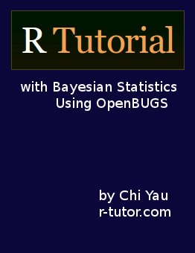
Data Types
A dataframe is a list of vectors of equal length
Use if columns (variables) are different types (numeric/character/logical etc.).
See the built-in data frame in R, called mtcars
Type in Rstudio console:
?mtcars READ
mtcars
head(mtcars)
nrow(mtcars)
ncol(mtcars)
Respond
http://www.r-tutor.com/content/r-tutorial-ebook

Slide 18

Data Types
A matrix is like a data frame
All columns in a matrix have the same mode (numeric, character, etc.) and the same length
Useful for some packages and problems
> matrix(1:9, nrow = 3, ncol = 3)
READ

Slide 19

Data Types
A list can hold any number of any types of other data
mylist <- list(x=c(1,5,7), y=c(4,2,6), z=c(0,3,4))
mylist
sapply(mylist, function(x) mean(x))

Slide 20
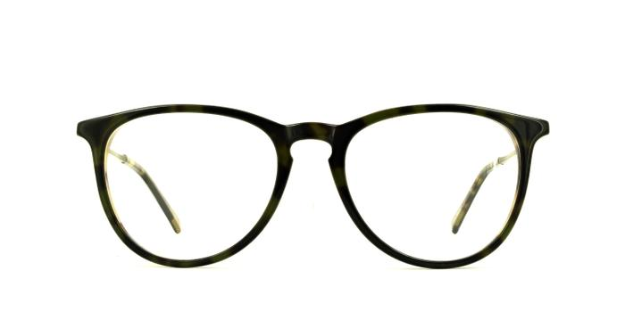
Importing Data
What is ?getwd READ
Find out where you are storing your files with getwd()
What is ?setwd READ
If you don’t like getwd(), change it with setwd()
Windows people talk about your working directory, help your neighbor

Slide 21
Importing Data
list.files()
First you must import your data into R
Take data stored in a file and load it into a data frame in R
Use helper for Data Input by typing
?read.csv READ
http://style.tidyverse.org/

Slide 22
Importing data
read.csv() reads comma delimited files
participants_data <- read.csv (“participants_data.csv”)
head(participants_data)
names(participants_data)
class(participants_data)

Slide 23

Wrangling
Once you have tidy data, a common first step is to transform it
narrowing in on observations of interest
creating new variables that are functions of existing variables
calculating a set of summary statistics
http://www.codeastar.com/data-wrangling/

Slide 24

Wrangling
Format of dplyr by H. Wickham
Arguments start with a data frame
select: return a subset of the columns
filter: extract a subset of rows
arrange: reorder rows
rename: rename variables
mutate: add new variables and columns or transform
summarize: generate summary statistics
Hadley Wickham
Notes:
R is an old language and does some things that may no longer be useful and possibly too confusing
Verbs used in dplyr

Slide 25

Wrangling
Using dplyr
install.packages("dplyr")
library(dplyr)
Roger Peng
http://genomicsclass.github.io/book/pages/dplyr_tutorial.html

Slide 26
Wrangling
Subsetting
Select
aca_work_filter<-select(participants_data, academic_parents, working_hours_per_day)
aca_work_filter
non_aca_work_filter<-select(participants_data, -academic_parents, -working_hours_per_day)
non_aca_work_filter
Base R alternative
aca_work<-participants_data[, c(8, 6)]
aca_work
non_aca_work<-participants_data[, c(8, 6)]
non_aca_work

Slide 27
Wrangling
Subsetting
Filter
work_filter<-filter(participants_data, working_hours_per_day >10)
work_filter
work_name_filter<-filter(participants_data, working_hours_per_day >10 & letters_in_first_name >6)
work_name_filter

Slide 28
Wrangling
Arrange
participants_data <- arrange(participants_data, letters_in_first_name) #ascending
participants_data
head(participants_data)
tail(participants_data)
participants_data <- arrange(participants_data, desc(letters_in_first_name)) #descending
participants_data

Slide 29
Wrangling
Rename
participants_data <- rename(participants_data, name_length = letters_in_first_name)
names(participants_data)
participants_data <- rename(participants_data,
daily_labor=letters_in_first_name)
names(participants_data)

Slide 30
Wrangling
Mutate
participants_data <- mutate(participants_data, daily_labor*mean(daily_labor, na.rm=T))
head(participants_data)
participants_data <- mutate(participants_data, number_of_siblings -mean(number_of_siblings))
head(participants_data)

Slide 31
Wrangling
Group by
Commute category
participants_data <- mutate(participants_data, commute = factor(1* (km_home_to_zef > 10), labels = c("commuter", "local")))
participants_data$commute
commuter_data <- group_by(participants_data, commute)
commuter_data
summarize(commuter_data, mean(days_to_email_response), median(name_length), max(years_of_study))

Slide 32

Wrangling
Pipeline %>% (saves on assigning data frames)
Do all the previous with a pipeline %>%
participants_data %>% mutate(commute = factor(1* (km_home_to_zef > 10), labels = c("commuter", "local"))) %>% group_by(commute) %>% summarize(mean(days_to_email_response), median(name_length), max(years_of_study)) %>% as.data.frame

Slide 33
Merging Data
Merge
library(dplyr)
full_join(commuter_data, participants_data)
Alternative in Base R
merge(commuter_data, participants_data, all=TRUE)

Slide 34
Descriptive Statistics
?summarize READ
summarize(participants_data)
?summary READ
summary(participants_data)
?str READ
str(participants_data)
tidyr has a function called describe() that returns the mean, min, max and n (homework)

Slide 35
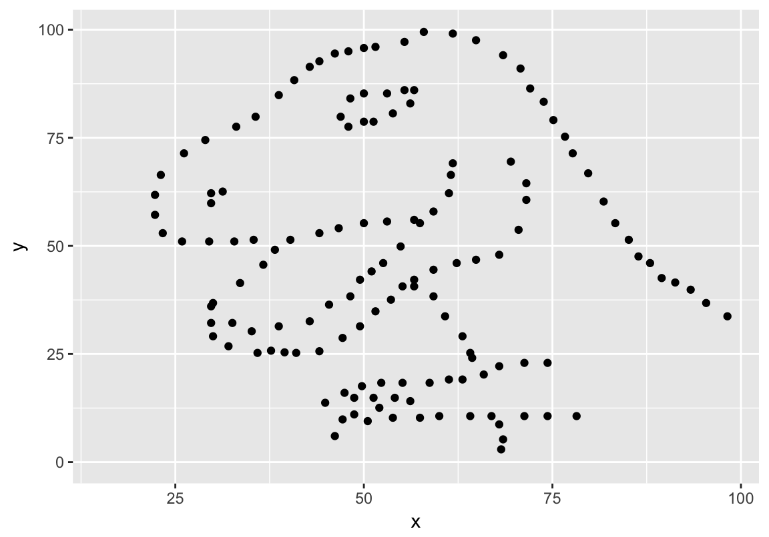
Descriptive Statistics
All have the same summary statistics
x mean=54.26,
y mean=47.83,
x SD=16.76,
y SD=26.93,
Pearson's R=-0.06
Justin Matejka, George Fitzmaurice, Datasaurus Dozen

